Slide 1

NTPC meeting its Coal requirement-Road Ahead
7th Roundtable Conference on Coal
24.09.2019
New Delhi

Slide 2
FOREWORD
NTPC caters to 1/4th of India’s Power requirement
10th largest power utility, Globally, in terms of capacity
Currently operating 55 GW of capacity (48 GW Thermal)
130 GW Capacity Target by 2032
512 in Forbes Global 2000 list
1 IPP in Platts Global Ranking 2018.
Ranked 14th “ Great Place to Work ” in 2019

Slide 3
NTPC at Glance
Present installed capacity 55,786 MW
  including 7,801 MW through JVs/Subsidiaries
Comprising of 53 NTPC Stations
  22 Coal based stations,
  7 combined cycle gas/liquid fuel based stations,
  2 Hydro based station,
  1 Wind based Station
10 Joint Venture stations
  9 coal based
  1 gas based
11 renewable energy projects
Target 130 GW by 2032 with diversified fuel mix

Slide 4
NTPC Capacity at a Glance
Fuel | Capacity (in MW)
Coal | 48074 (31 Plants)
Gas | 5984.31 (8 Plants)
RES | 928 (11 Solar Projects)
Hydro | 800 (1 Project)
Total | 55786.31

Slide 5
Coal Sourcing(2018-19)
Station Capacity | 47,414 MW
Coal Consumption | 188.23 MMT
Coal receipt | 176.74 MMT – ACQ 7.7 MMT – MOU 1.76 MMT– E-Auction 6.3 MMT – Captive Mine 1.16 MMT – Import Coal Total- 193.66
Coal Requirement at 85% PLF | 229 MMT

Slide 6
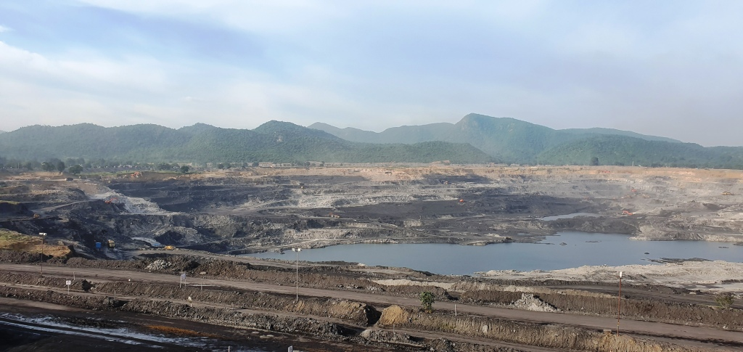
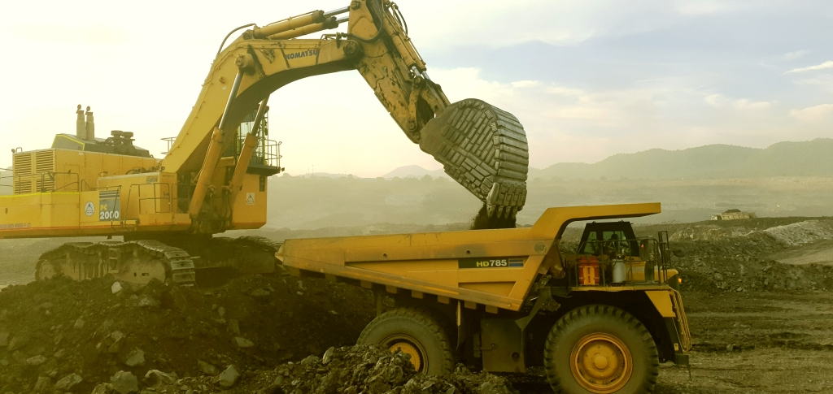
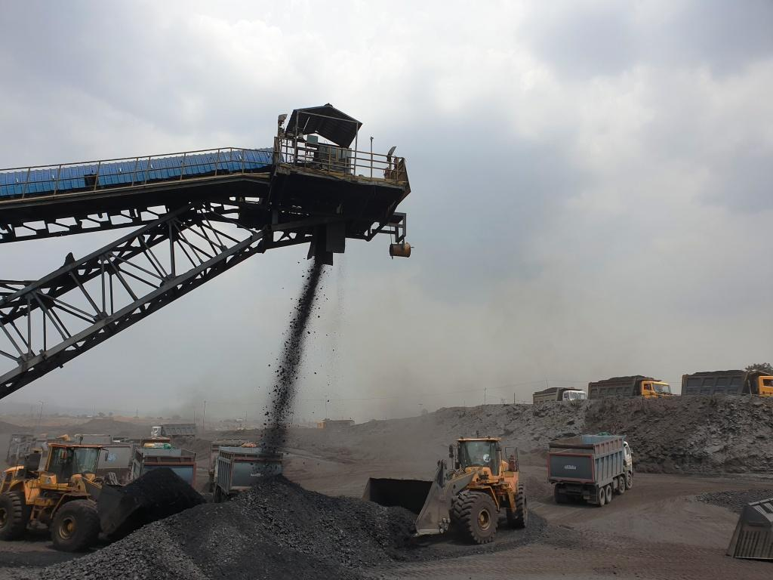
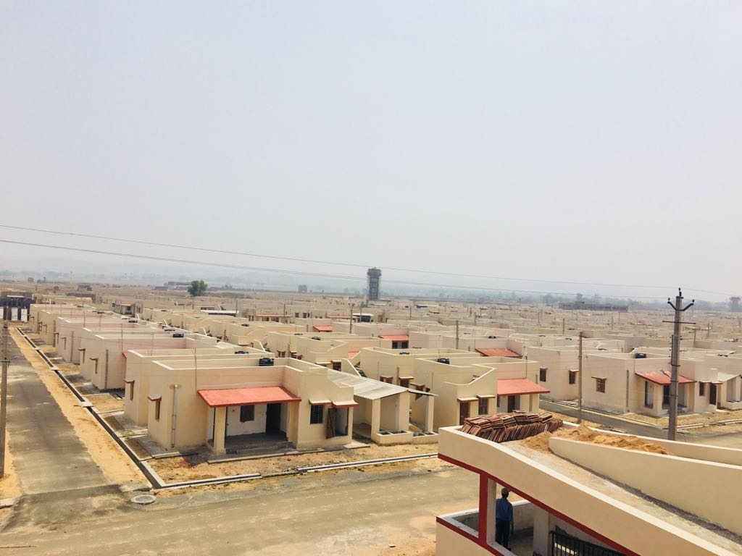
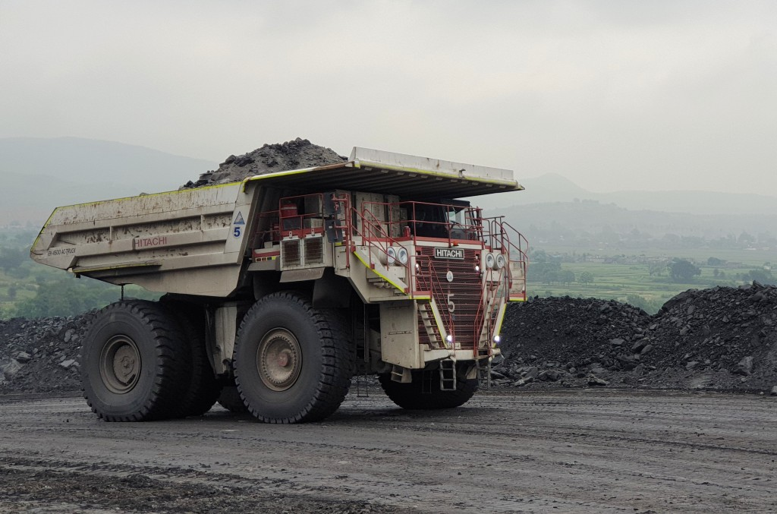
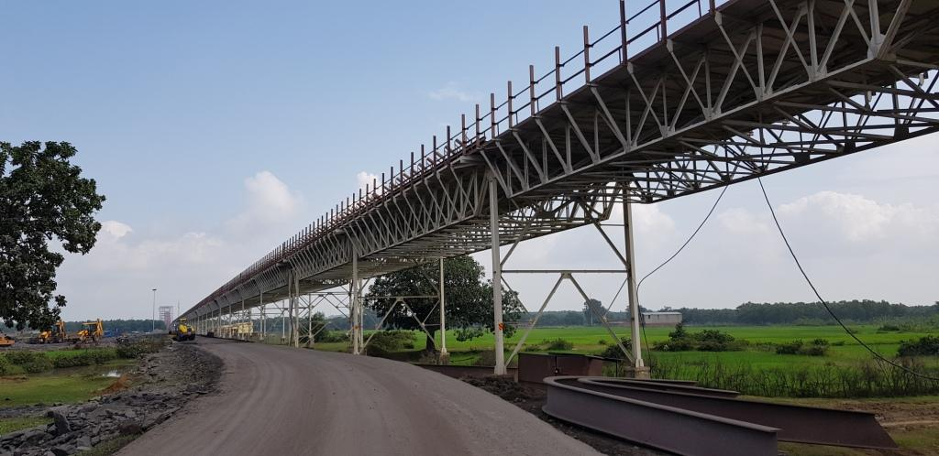
NTPC Coal Mining Projects

Slide 7
Our Objectives
To have fuel Security
To secure assured Quality and Quantity of coal supply
To attain price competitiveness on the delivered coal

Slide 8
Foray into Coal Mining
Re-allocation of Coal blocks to NTPC - 2015.
Mining commenced in Pakri-Barwadih CMP – May,2016.
Dulanga CMP operationalized –Feb,2018
Functioning of “Coal Mining Head Quarters ,Ranchi” –Aug,2018.
“NTPC Mining Ltd”a wholly owned subsidiary, launched in Aug,19
Tallaipali (South) commencement scheduled in Nov’19
Kerendari CMP scheduled in Nov’19(Limited Outsourcing)
Tallaipali (W) & Chatti-Bariatu(S) scheduled in Dec,2019

Slide 9
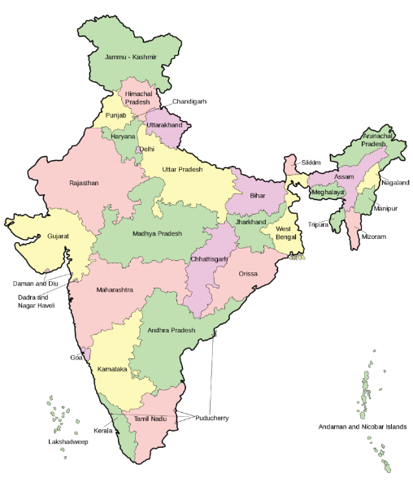
NTPC’s Coal Mining Projects
Sl | Name of Coal Blocks | Est. Mine Capacity (MTPA) | EUP (End use Plant)
1 | Pakri-Barwadih | 18 | Basket mine
2 | Chatti-Bariatu & CB(South) | 7 | Barh-II
3 | Kerandari | 6 | Tanda-II
4 | Dulanga | 7 | Darlipalli
5 | Talaipalli | 18 | Lara
6 | Banai | 12 | Barethi-I
7 | Bhalumuda | 11 | Kudgi
8 | Mandakini - B | 20 | Telengana
9 | Banhardih (JV) | 8 | Patratu
10 | Badam (JV) | 3 | Baruni-II
TOTAL |  | 110
Pakri-Barwadih | Chatti-Bariatu & Chatti-Bariatu(South) | Kerandari
North Karanpura CF, Jharkhand
Banhardih
Auranga CF, Jharkhand
Talaipalli
Mand-Raigarh CF, Chhattisgarh
Coal Based Plants | 22 Nos
Coal Reserve | 7.2 Billion Tonne
Estimated Coal Production | 110 MT
Dulanga
IB Valley CF, Odisha
Banai | Bhalumuda
Mand-Raigarh CF, Chhattisgarh
Mandakini-B
Talcher CF, Odisha,
Badam Coal Block
North Karanpua Jharkhand

Slide 10
Production Plan of Coal Mining Projects Fig. in million tonnes
Name of block/Year | 2019-20 | 2020-21 | 2021-22 | 2022-23 | 2030-31
Pakri-Barwadih | 8.63 | 10.0 | 11.0 | 12.0 | 18.0
Dulanga | 2.5 | 4.5 | 7.0 | 7.0 | 8.0
Talaipalli(South) | 0.5 | 4.0 | 8.0 | 13.0 | 18.0
Kerendari | 0.3 | 2.6 | 3.3 | 6.0 | 6.0
Chatti-Bariatu | - | 1.0 | 3.0 | 5.0 | 7.0
Mandakini-B | - | 0.5 | 2.0 | 4.0 | 20.0
Banai& Bhalumuda | - | - | - | - | 12.0
Banhardih | - | - | - | - | 8.0
Badam | - | - | - | - | 3.0
Total | 11.93* | 22.6 | 34.3 | 47 | 100

Slide 11
Our Risks
Renewable Energy
Land Acquisition
Coal Sourcing
Environmental Compliances
    Ash Utilization
Market Share
Regulatory Changes
Adverse Geology
Land Acquisition
Safety & Env. Compliances
Coal evacuation
Statutory
Manpower

Slide 12
Our Challenges
Technological | Regional | Legal | Administrative
Steep Seam Adverse stripping Ratio Deep seated deposits Partly explored block Coal evacuation system HEMM procurement Faster ramp up | Thickly populated terrains Dense Forest Varied State R&R policies Law & Order | Contract Labour Exemption Compliant entity Switch over to departmental mining | Formative Stage Statutory frame work Sustainability Securing brand image of NTPC with Coal Mining footprint

Slide 13
Our USPs
Innovation & Excellence.
Health & Safety
Rigid Compliances
Employee empowerment
Unique work culture
Flexible Role Orientation
Integrity & Work ethics

Slide 14
Inductions on the anvil ..
Establishment | Widening Coal Organization Structure Regional Head Quarters
Technology | Continuous Mining System In-pit crushing & conveying Electrical-Hybrid HEMM (High capacity Shovels & Dumpers) Geo-fencing Mine Automation
Environment | Water Positivity Fly ash Utilization

Slide 15
Our partners..
Thriveni Sainik Mining Ltd in Pakri Barwadih Project-18 MTY
Sainik Mining Allied Services in Dulanga Project- 7 MTY
Chatwal Infra Pvt Ltd in Tallaipali(South)-2 MTY
Tecpro
L&T

Slide 16
Thank You

